Slide 1
Data Insights
British Airway Reviews Analysis

Slide 2
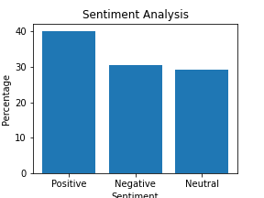
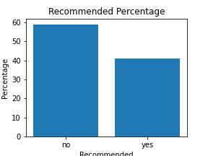
Key Metrics and Visualizations
Sentiment Analysis: Positive: 40.159574% Negative: 30.585106% Neutral: 29.255319%
Recommended Percentage: no: 59.042553% yes: 40.957447%

